Slide 1
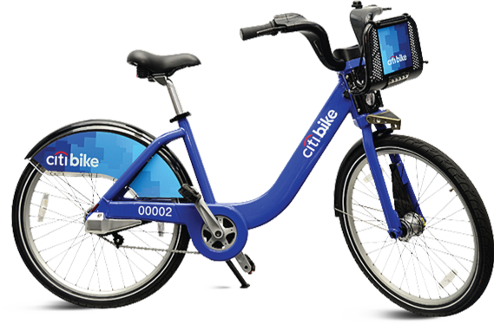
Data Analysis and Visualization of NYC Citi Bike Trips for Business Intelligence
MIS 636- Data Warehousing and Business Intelligence FALL -2020 Final Project
Mahaswin Ramalingam Balaji

Slide 2
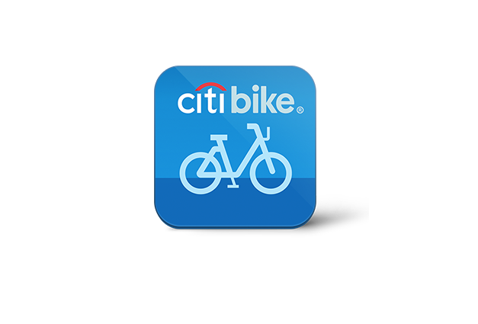
Agenda
Company Profile
Why DW and BI
BUS Matrix
Opportunity Matrix
Sample Data
Logical Fact Table
Steps to create Dimensional Modelling
Fact Table
Dimension Table
High Level Data Model
Slowly Changing Dimension
OLAP Cube
Tableau Visualization
Dashboard Insights
Conclusion

Slide 3
Citibike Company Profile
Citibike is a public bike sharing program that allows users to ride rented bicycles from one bike station to another.
Users can check bike availability at the station or on the mobile app and pick up a bike at one of the many stations around the city. They can end a ride by returning the bike to any station and sliding the bike firmly into an empty dock
The density of bike share stations makes it convenient for riders to find and return bikes and this makes Citibike very successful.
This project shows how Citi Bike, relates to the existing travel modes, and the characteristics of its users.
Citibike is the largest bike-share program in the United States. It is most popular in New York City , and in its first two years has become a key element in the city’s transportation network.

Slide 4
Why DW and BI
Helps in maintaining historical records.
Helps in analyzing the data to gain a better understanding of the business and to improve the business.
Promotes better business intelligence for end-users
Reduction in time to locate, access, and analyze information
Effective Consolidation of disparate information sources
Enables less time-to-market for products and services

Slide 5
Bus Matrix
Bus matrix is used to describe dimension reuse across subjects
Bus matrix takes business processes breaks them into objects that participate in those business processes
It is a tool for designing and communicating the enterprise data warehouse bus architecture.
The rows of the matrix are business processes, and the columns are dimensions.
The cells of the matrix are then marked to indicate which dimensions apply to which processes.

Slide 6
Bus Matrix
Business Process | Time | BikeStation | User_Info | Bicycle | Rental | Employee
Citibike Mobile App Sales transaction | x | x | x | x | x
Sales transaction at Bike Station | x | x | x | x | x | x
Vendor Sales Transaction | x | x | x |  | x
Return process | x | x | x | x |  | x

Slide 7
Opportunity Matrix
The matrix consists of business processes versus the department or workgroups in the organization.
The matrix indicates which business functions/ departments are interested in which business processes in the organization.
The Opportunity or stakeholder matrix helps identify which business groups should be invited to the collaborative design sessions for each process-centric row.

Slide 8
Opportunity Matrix
Business Process | Customer Service | Finance | Operations | Marketing | Logistics | Strategy Management
Citibike Mobile App Sales transaction | x | x | x | x | x | x
Sales transaction at Bike Station | x | x | x | x | x | x
Vendor Sales Transaction | x | x |  | x | x
Trip Processing | x |  | x
Return process | x |  | x |  | x

Slide 9
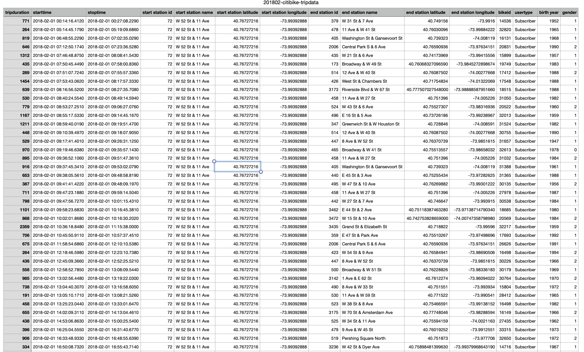
Sample Data

Slide 10
Columns in the Data
Trip Duration (seconds)
Start Time and Date
Stop Time and Date
Start Station Name
End Station Name
Station ID
Station Lat/Long
Bike ID
User Type (Customer = 24-hour pass or 3-day pass user; Subscriber = Annual Member)
Gender (Zero=unknown; 1=male; 2=female)
Year of Birth

Slide 11
Steps to create Dimensional Modelling
Select Business Process
OrgX – citibike Renting Process
Choose the Grain of the Business Process
OrgX – Each Rider, Trip
Choose Dimensions of the Business Process
OrgX – Rider, Trip, Bike, Bike Station Info
Choose the measured Facts
Orgx – # of bikes/docks available per station, total trip time, active riders renting at any given point in time, bike rented status at any given point in time

Slide 12
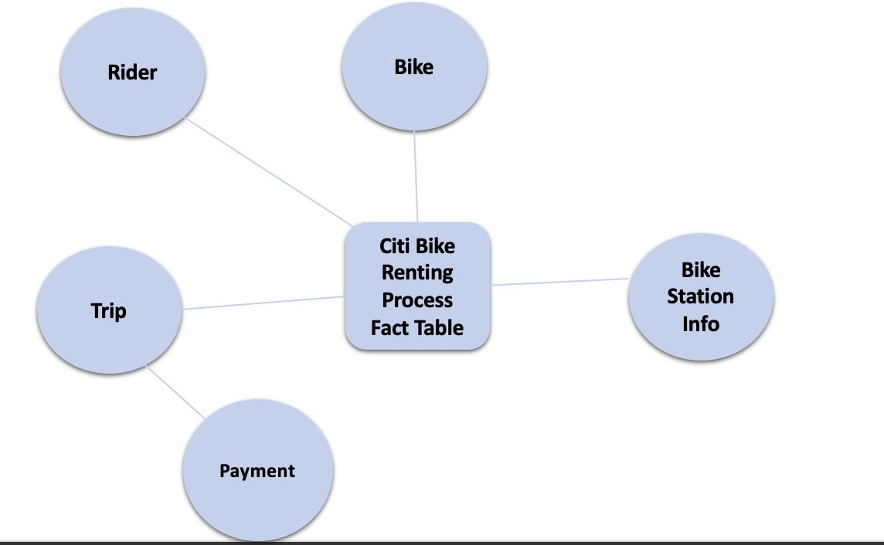
High level data model

Slide 13
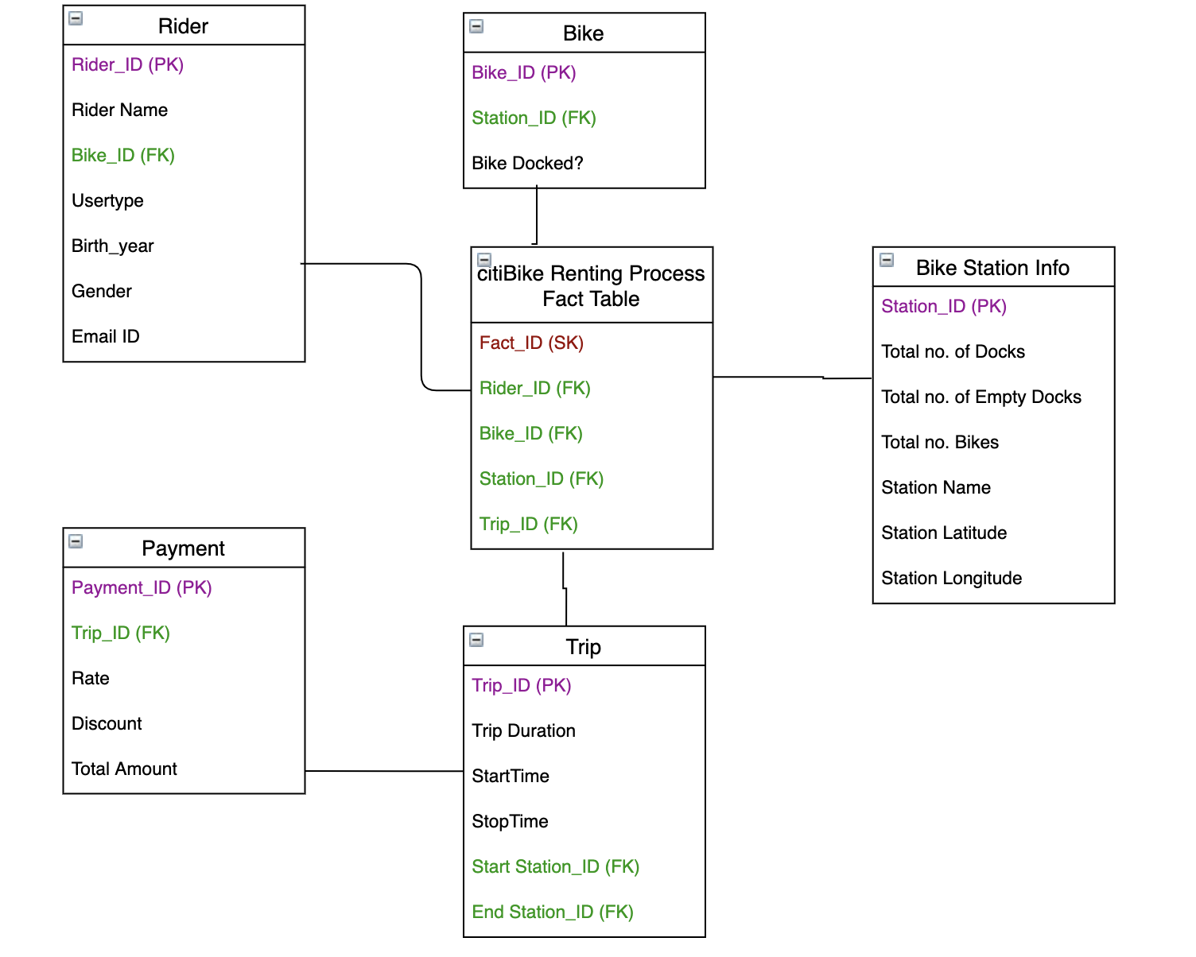
Logical Fact Table Diagram

Slide 14
Fact Table
A fact table consists of facts of a particular business process. Facts are also known as measurements or metrics. A fact table record captures a measurement or a metric.
A fact table is used in the dimensional model in data warehouse design. A fact table is found at the center of a star schema or snowflake schema surrounded by dimension tables.
Fact_ID(SK)
Bike_ID(FK)
Rider_ID(FK)
Station_ID(FK)
Trip_ID(FK)

Slide 15
Dimension Table
A dimension is a structure that categorizes facts and measure in order to answer business question
A Dimension Table is a table in a star schema of a data warehouse. Data warehouses are built using dimensional data models which consist of fact and dimension tables
Dimension tables are used to describe dimensions, they contain dimension keys, values and attributes
Dimension Tables
Rider
Trip
Bike
Bike Station Info

Slide 16
Conformed dimension
A conformed dimension provides the same meaning to every fact table in a data warehouse which it relates.
A single conformed dimension table can be used against multiple fact tables in the same data mart, or a replicated dimension can be used in more than one data mart.
So, for our data warehouse, following dimensions remain the same
Rider dimension
Bike dimension
Trip Dimension

Slide 17
Slowly Changing Dimension
Bike Station Info
Type 1
In this scenario, the old record with the number of docks would be deleted and a new record with the new values would be inserted
Updating Station Name
Type 2
In this scenario, a new row would be added with new Station name to maintain the history

Slide 18
Dimensional Table Detailed Diagram: Bike Station Info Table
Attribute Name | Attribute Description | Slowly changing dimensions policy | Sample Values
Station_ID | The Trip ID is the ID associated | Type-0: No Action | 072
Total number of Docks | Total number of docks available at the station | Type-1: Overwrites | 3
Total Number of Empty Docks | Number of Empty docks available for bike docking at the station | Type-0: No Action | 379
Total No. Bikes | Number of bikes currently docked at the station | Type-0: No Action | W 52 St & 11 Ave
Station Name | Each station has specific name | Type-2: Add New Row | W 31 St & 7 Ave
Station Latitude | Each Station has specific latitude | Type-0: No Action | 40.76727216
Station Longitude | Each Station has specific longitude | Type-0: No Action | -73.99392888

Slide 19
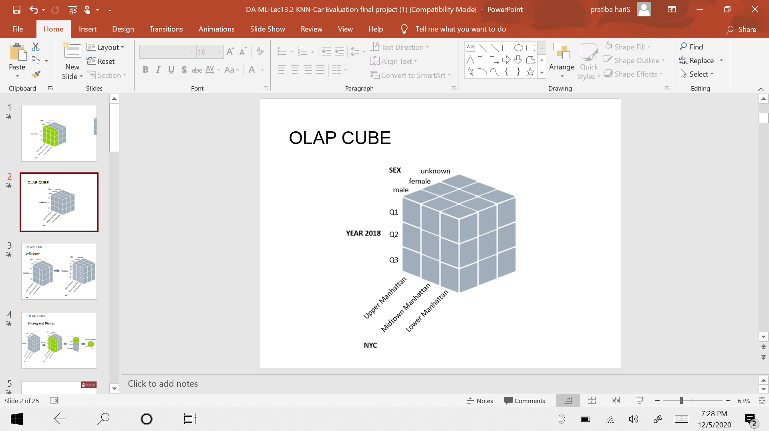
OLAP CUBE
It is a category of software that allows users to analyze information from multiple database systems at the same time.
OLAP databases are divided into one or more cubes. The cubes are designed in such a way that creating and viewing reports become easy.
It is a technology that enables analysts to extract and view business data from different points of view.
Analysts frequently need to group, aggregate and join data. With OLAP data can be pre-calculated and pre-aggregated, making analysis faster.

Slide 20
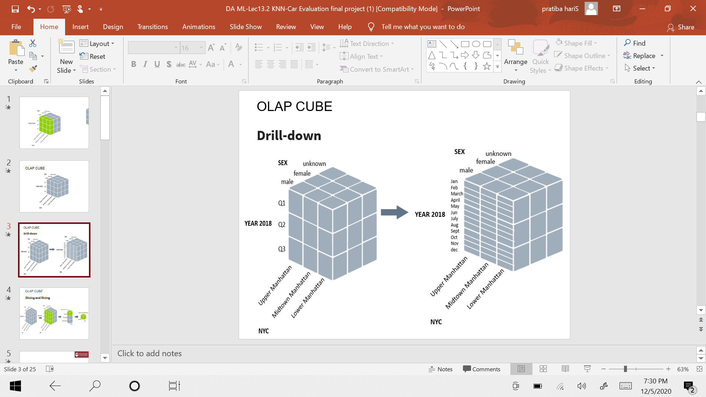
Drill down

Slide 21
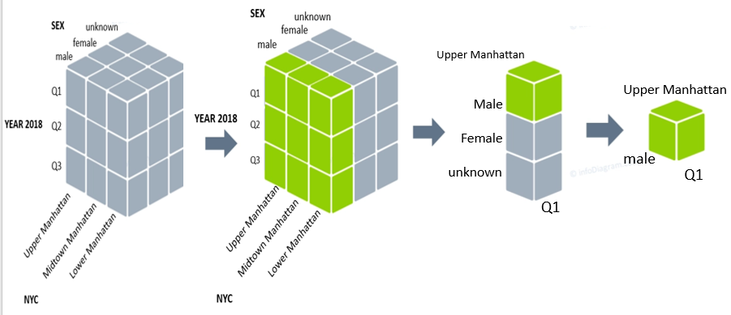
Slicing and Dicing

Slide 22
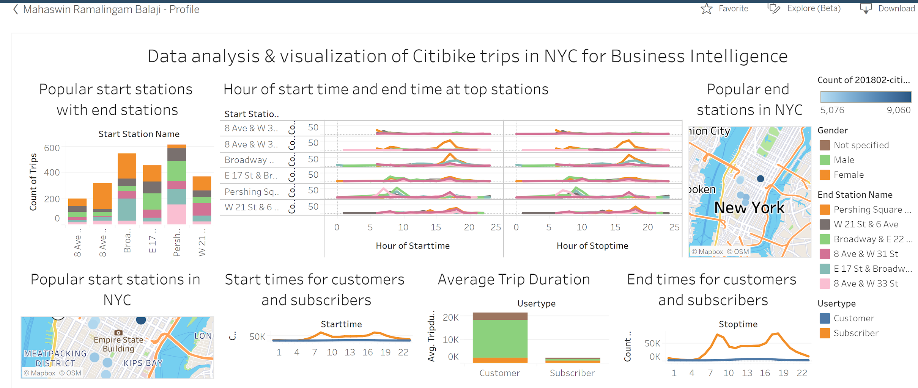
Citibike BI Dashboard-Click to view

Slide 23
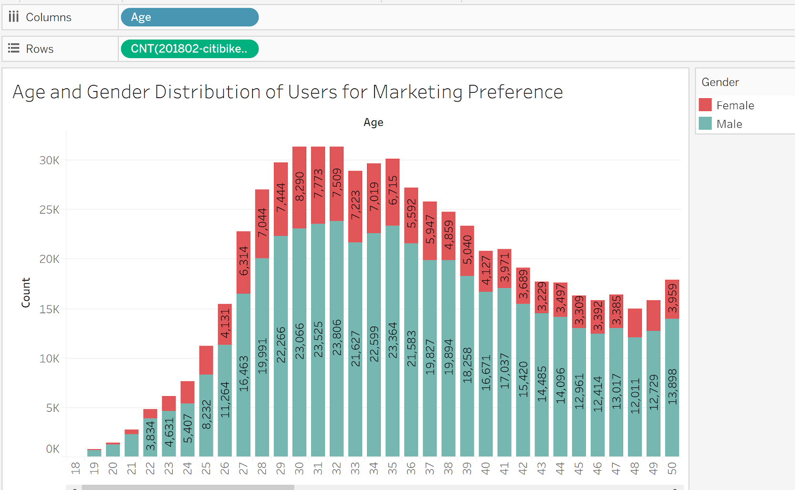
Age and Gender Distribution for Marketing
Classification of Users based on Age and Gender
Male: Higher usage activity for ages 30-32
Female: Higher Usage activity for ages 29-33

Slide 24
Dashboard Insights
Most Popular Start Station- Pershing Square
Most Popular End Station- Pershing Square and Broadway at E 22nd street
The hours of start time and end time at stations almost follow a similar pattern which can be observed from the dashboard that maximum number of starts and stops are around 8AM and between 5-6PM. This could be due to the fact that most office goers use the service
Average Trip Duration of customers are much higher than that of subscribers and males outweigh female users

Slide 25
Conclusion
The Citi might want to consider age when planning out things like bike infrastructure, much in the way that they do for crosswalks.
As we can see that daily office workers use service more but it should be used in the odd times of the day too so Citi Bike could investigate adding more bikes to tourist heavy areas or any other way so that the non used service time is utilized.
Citi Bike should consider adding promotional offers or student discounts to their subscribers to attract more youth in using Citi Bike.
Citi Bike should introduce any new schemes where it would attract more female customers maybe by introducing female friendly bikes as we can see that males use the service more than females.

Slide 26
Thank You

